Slide 1
-hour Outdoor Photometric Stereo
Yannick Hold-Geoffroy¹, Jinsong Zhang², Paulo F. U. Gotardo³, and Jean-François Lalonde¹
¹Laval University, Quebec City
²Beihang University, Beijing
³Disney Research, Pittsburgh

Slide 2
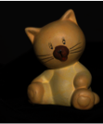
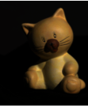
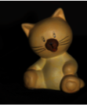
Photometric Stereo
Images of object under
different light directions (point sources)
Surface normals
…
+ albedo
(unlit color)
Images: Neel Joshi, Ira Kemelmacher, Ian Simon (CSE 455, Winter 2010)
Notes:
Photometric stereo is a shape reconstruction technique which has been studied extensively since its creation in the early eighties. The original idea is to recover the shape from several images of a single object lit from different directions.
Recently, people started to apply these algorithms on images captured outdoors. The first thing researchers did to handle this scenario is to model the sun as a PLS.

Slide 3
PS - point light sources
light
direction
scaled
surface
normal
pixel
intensity
Must be rank 3!
Notes:
Assuming Lamb. reflectance, it is well known that the appearance of a pixel b, is defined as the inner product of the light direction L and the surface normal scaled by the albedo, n. When we have multiple images, we build the system of linear equations which we can solve to recover the normal. The important thing here is we must have at least 3 non-coplanar light sources. This is because we’ve got 3 unknowns, the 3 dimensions, so L has to be rank 3. Until recently, the vast majority of the work in PS has so far focused on images captured indoors, in laboratory conditions, where controlling the lighting is easy.
\bold{b} = \left[ \begin{array}{c}
b_1 \\
b_2 \\
\ldots \\
b_m \end{array} \right]
=
\left[ \begin{array}{c}
\bold{l}^T_1 \\
\bold{l}^T_2 \\
\ldots \\
\bold{l}^T_m \end{array} \right] \bold{n}
= L\bold{n}

Slide 4
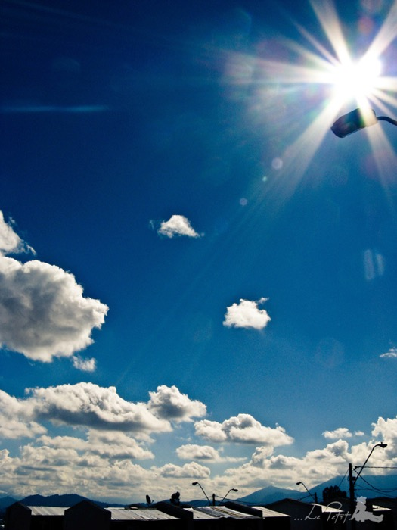
Outdoor Photometric Stereo
Cannot control the sun!
Sun moves on a plane during the course of a day
Notes:
The main challenge with outdoor data as opposed to the lab, is that we cannot control the lighting. But that causes a problem, because remember that to have a stable reconstruction, we have to light the object from at least three non-coplanar directions. The sun gives a lot more than three lighting directions over the course of a day, but they all lie on the same plane. That causes the problem to be underconstrained, so we cannot reconstruct the normals accurately on small time intervals.

Slide 5
Solution #1
Months
[Abrams et al., ECCV’12]
[Ackermann et al., CVPR’12]
Notes:
To deal with this issue, people have proposed to simply gather months of data to ensure that the sun, modelled as a point light source, moves out of the a single plane. But waiting for this amount of time is tedious.

Slide 6
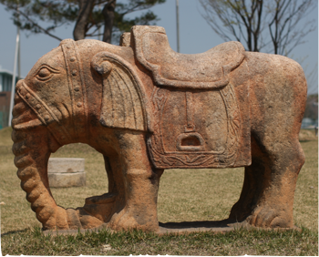
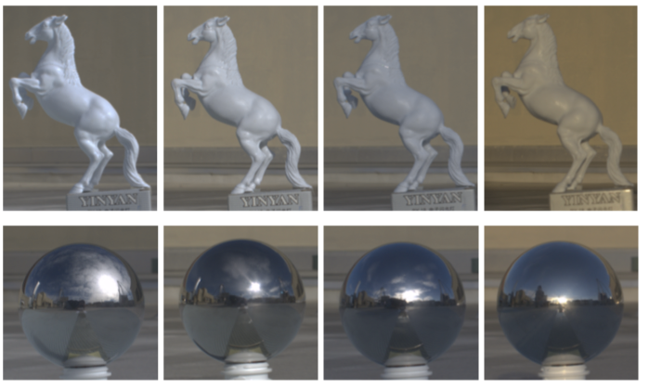
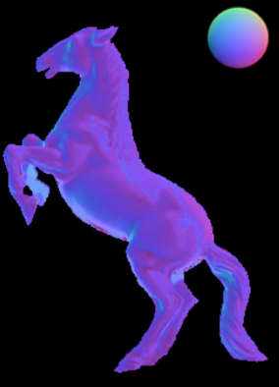
Solution #2
Months
Day
Yu et al., ICCP’13
Jung et al., CVPR’15
Notes:
Another solution involves looking at a single day instead of many months. A promising avenue brought by Yu et al., is to use more elaborate models of illumination as input to outdoor PS, such as HDR environment maps. Jung et al. pushed this idea further by using a physically-based sky model. Photometric stereo can now be tackled in terms of days instead of months.

Slide 7
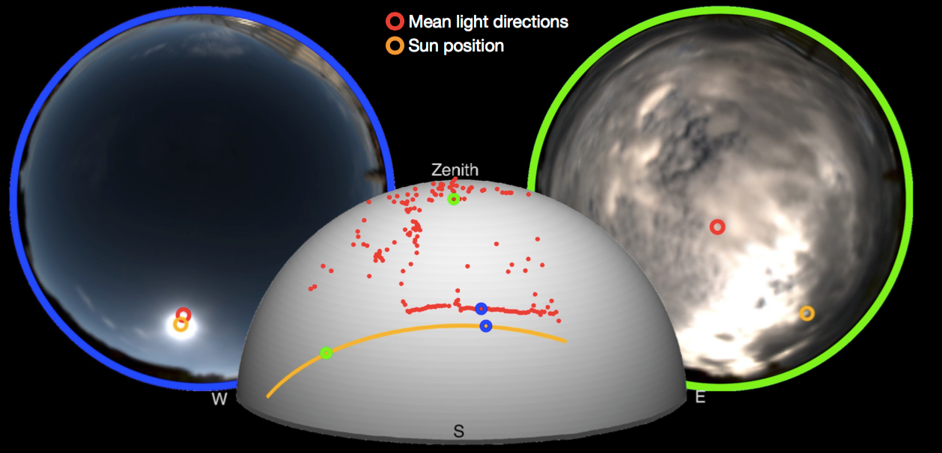
Solution #2
Months
Which day?
Hold-Geoffroy et al., ICCP’15
Notes:
Earlier this year, we provided an analysis that allowed us to compare the performance of oPS across different types of days. For example, we found that partly cloudy days yield better performance than either full sunny or fully overcast days.
Now, the question is…

Slide 8
Months
Day
Hour(s) ?
Notes:
Can we do it under one day? Is 6 hours necessary? Two hours? One hour?

Slide 9
Perform PS on small time intervals
1. Why does outdoor PS work?
2. Can it work in x hours? (x ≤ 6)
Notes:
In this paper, we see that we can, under certain circumstances, perform PS on small time intervals.
We’re going to talk about two things:
What needs to happen in order for Outdoor PS to work, when we’re at the mercy of the elements.
Can it happen during less than a day, for example less than 6 hours. Why 6? because we consider 6 hours to be a full day.
We’re not proposing a new algorithm, but rather propose an analysis to better understand OPS…

Slide 10
Environment maps
08/24/2013
light clouds
85% sun visibility
11/06/2013
mixed
41% sun visibility
11/08/2014
overcast
16% sun visibility
Online database: hdrdb.com
Notes:
To answer the questions we have, we’re using a database which contains HDR environment maps of the sky for 23 days. We’re sharing a subset of this data on hdrdb.com . We’re going to use this data to perform our analysis.

Slide 11
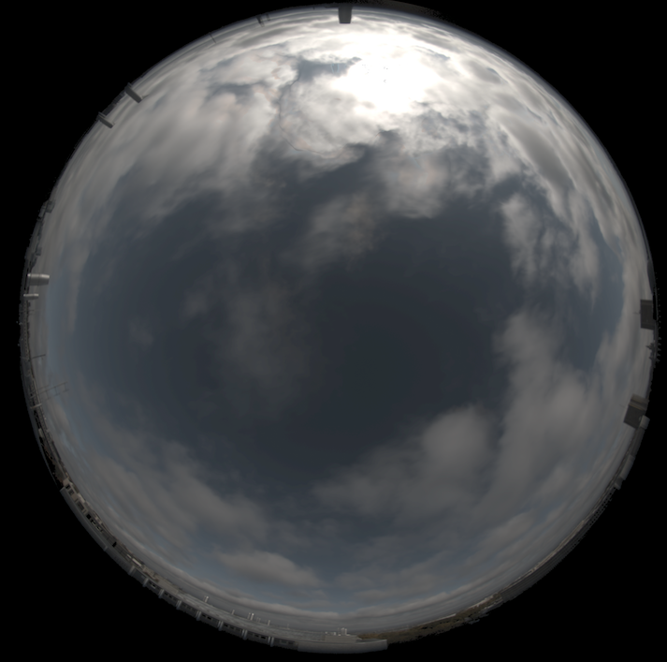
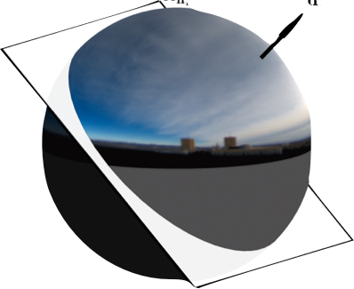
What are we going to see?
Environment maps
Lighting model
Fine grained analysis
Error
Notes:
Now that have defined what are envmaps, we will use them to model the illumination, giving us a more adequate calibration than the PLS model for oPS. Next, we’ll define a performance measure in order to talk about what happens hour by hour, minute by minute in oPS.

Slide 12
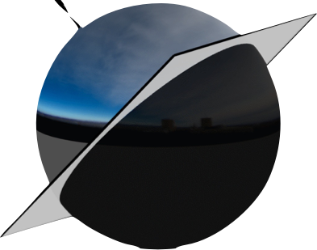
PS - environment map lighting
Integration hemisphere
Mean
light
vector
Mean
light
vector
Notes:
To understand what’s going on, we must understand how a surface patch is lit. Instead of taking the lighting from a single point light source, we take the mean of the visible hemisphere in the environment map.
The MLV depends on the envmap but also on the normal!

Slide 13
Key points about MLVs
An MLV is a virtual point light
But, it depends on the surface normal
Point light source
Environment map
Matrix of light directions
Matrix of mean light vectors
Notes:
To summarize, we have some key points about the MLVs:
An MLV is a virtual point light
Remember the equation we had before for the PLS? Well, we have the same one, but using the mean light vectors instead.
But remember, this matrix of MLVs s dependent on the surface normal.

Slide 14
Point light source vs environment map lighting
Integration hemisphere
Point light source
Environment map
Matrix of light directions
Matrix of mean light vectors
Notes:
But: nonlinear equations disguised as linear ones

Slide 15
Mean Light Vector shifts - sunny day
Notes:
Now that we’ve defined the Mean Light vector, let’s take a look at what makes PS work.
Let’s take for example a sunny day. At the beginning of the day, the MLV of a normal seeing the sun points roughly towards it. Over the course of the day…

Slide 16
Mean Light Vector shifts - sunny day
Notes:
… the MLV continues to follow the sun.

Slide 17
Mean Light Vector shifts
solar plane
ill-conditioned
Notes:
MLVs behaves like the PLS in this case case: they lie on a path that follows the solar plane.
In the case of a totally overcast day…

Slide 18
Mean Light Vector shifts - overcast day
solar plane
ill-conditioned
Notes:
We won’t see much of the sun, because it is hidden by the clouds. The MLVs are then potentially far from the solar plane, but they are all pointing roughly the same direction.
But let’s get back to the sunny case…

Slide 19
Mean Light Vector shifts
solar plane
Notes:
From this case, we can move to a partly cloudy day…

Slide 20
Mean Light Vector shifts - partly cloudy day
Better behaved
out-of-plane shifts
solar plane
Notes:
… On partly cloudy days, clear envmaps gives MLVs following the solar plane while slightly overcast envmaps shift the MLV away from it. This constrains the PS problem better than the previous cases.

Slide 21
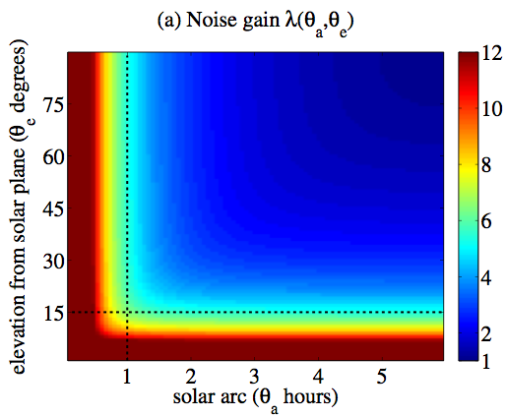
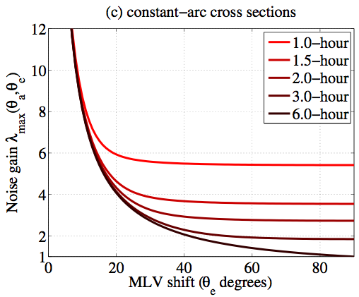
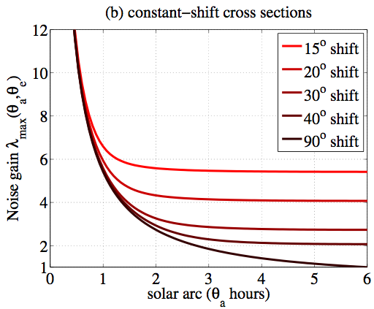

Slide 22
Normal
MLVs
Sun position
Notes:
Here’s an example. The sun position is shown on the dashed line, that would be the PLS model. All the coloured dots represent an MLV (obtained from an envmap from a partially cloudy day), color coded by their intensity.
Notice how the current analysis is made for a single normal, pointing toward zenith. I’m going to swipe the normal analyzed from zenith all the way down. See how the MLVs are spread out for normals pointing toward zenith.
Look how the MLVs collapse when the normal is around the equator. This is even more visible when swiping from E to W: shifting happens, but the results are coplanar with the previous MLVs.

Slide 23
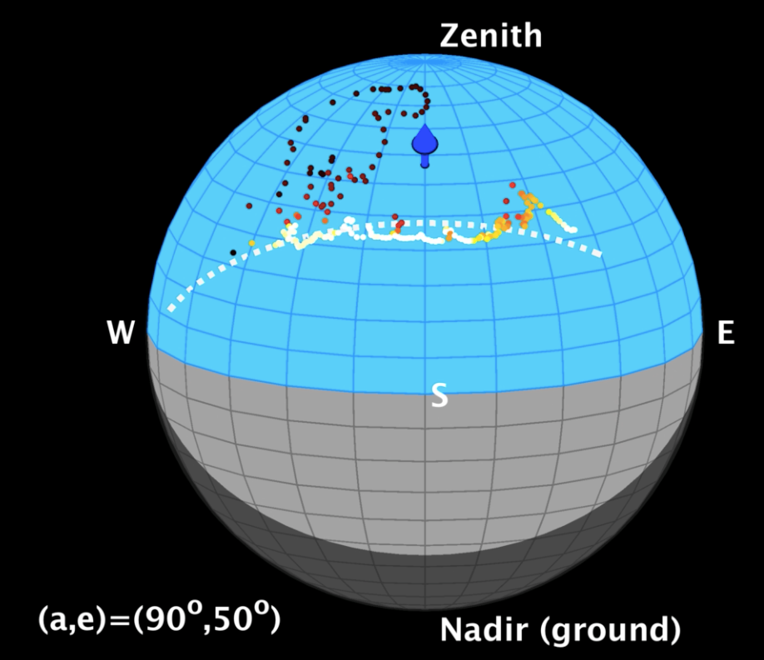
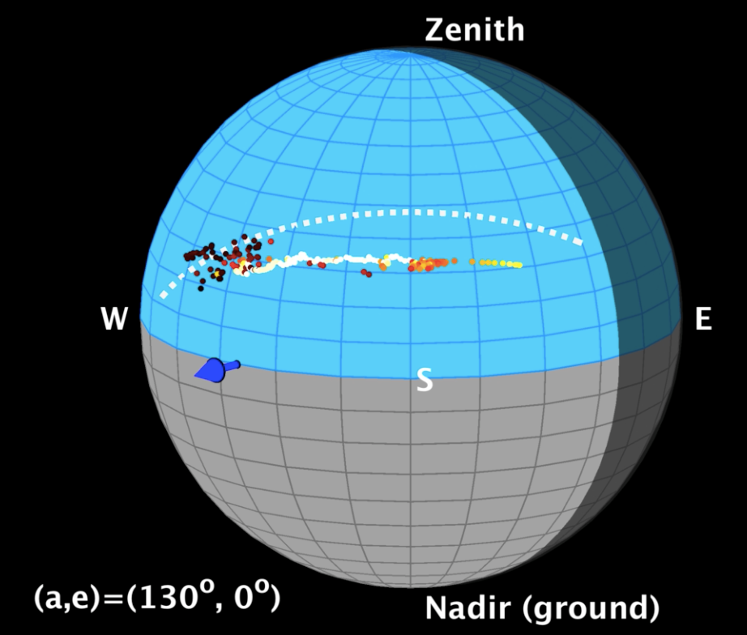
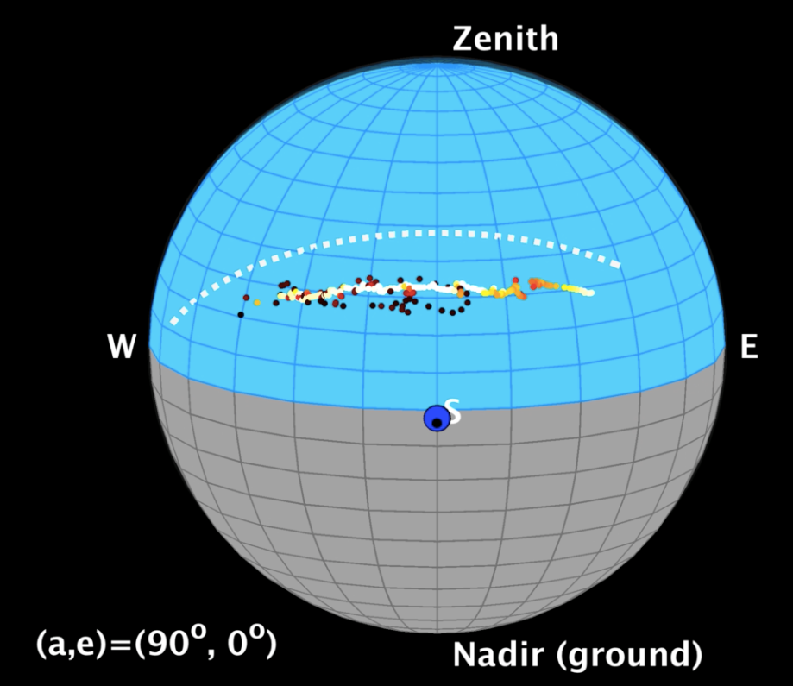
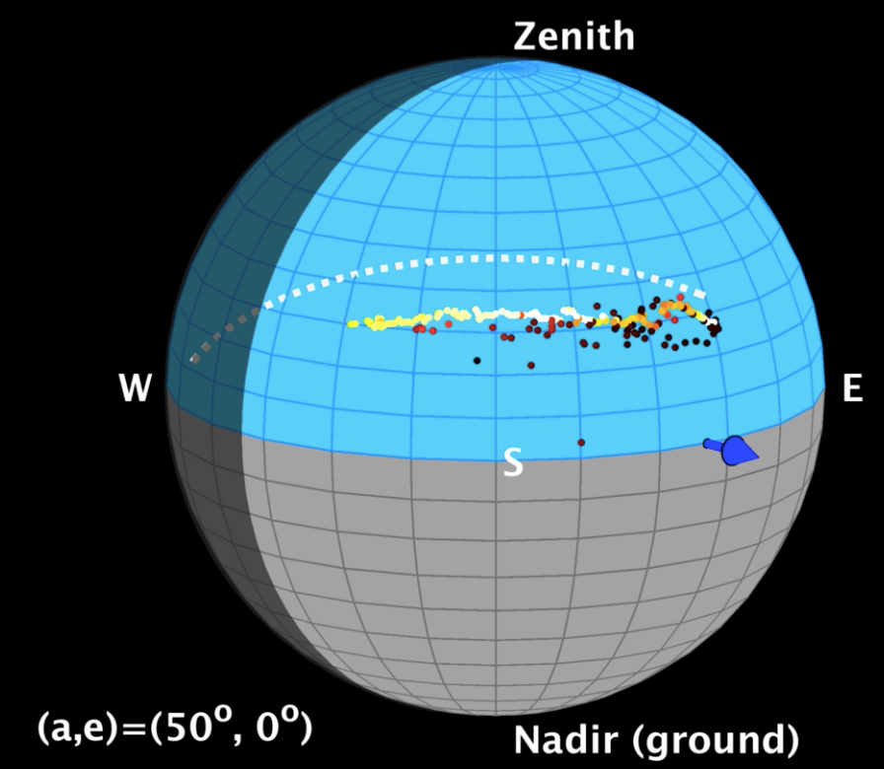
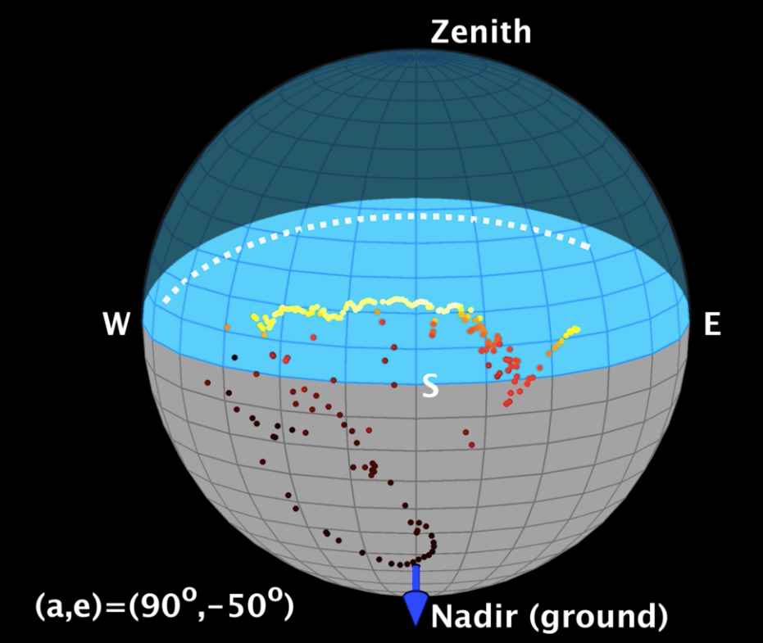
Normal
MLVs
Sun position
Notes:
Here are 5 frames from the previous video.
When the MLVs are bright, they follow the solar path. When the MLVs are dim, they are shifted toward the normal. As you can see, normals around the equator exhibit a zero-crossing where the shifting will still be coplanar with the other captures.
How do we quantify these shifts?

Slide 24
Measure: maximum
uncertainty
Uncertainty is higher for nearly horizontal normals
Notes:
…The maximum uncertainty. This measure is based on the conditioning of the L matrix. This L matrix is the stacked MLVs of all the environment maps. I refer you to the paper for a formal definition of the maximum uncertainty.
This is what we’re going to use to quantify the reconstructability of a normal.
Can be seen as an amplification of noise.
Here is an example of this metric for the previous day. We computed the uncertainty for all the normals of a sphere. As you can see, most of the sphere yields a low uncertainty, with the exception of normals on the equator. This is due to the collapse of the MLVs from the earlier video. So the shifts made by clouds, which gives the spread out MLVs, are important to lower the uncertainty.
Now, the question is…

Slide 25
Is MLV shifting observable within hours?

Slide 26
11:00
Notes:
If we begin the capture at 11 o’clock, we see that in the first moments, for the first half hour, the uncertainty is high.
As you can see, the performance is color-coded, each color point is the median performance obtained over a sphere.

Slide 27
11:00
Notes:
If I capture until 14h, I see that the expected performance is roughly the same than after the first half hour. It means that some important data were captured around 11h30, and the rest of the captures doesn’t improve much the conditioning of the problem.

Slide 28
11:00
Notes:
If I continue until 17h, though, I see a big performance increase around 14h15.

Slide 29
11:00
Notes:
Things happened in the sky that improved the conditioning of the problem…
This video shows the environment maps of the entire day. We’ll focus on what’s happening in a moment, but first, we only ran this analysis from 11h. We can continue this analysis…

Slide 30
11:00
Notes:
If we were to start at noon, instead, we’d get these results, where the uncertainty would stay really bad until around 2h. Now, we can repeat this analysis for all the possible time intervals over a day…

Slide 31
11:00
Notes:
The x-axis being the start time of the capture.

Slide 32
11:00
Notes:
14h -> predict good
noon -> predict bad
I will bring your attention on the line around 14h. This abrupt increase in performance reconstruction is due to what happens in the sky. More precisely, at this moment
[Mettre vidéos]

Slide 33
11:00
Notes:
More precisely, at this moment, ribbon-like clouds appear, making rapid shifts between MLVs.

Slide 34
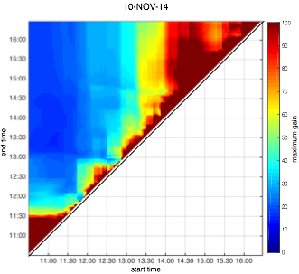
Notes:
Here’s another day which seems to work better in the morning. The plots for all the days from our database are available in the supplementary material.

Slide 35
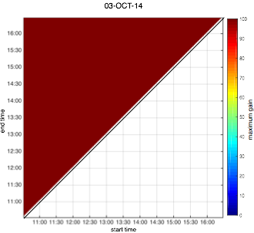
Notes:
As it is a sunny day, the MLVs all follow the solar plane, giving a bad conditioning. There is no interval improving enough the conditioning of the problem.

Slide 36
How often does it happen?
50% half days
< 2x full day
Notes:
Let’s go back to the original question: How often does MLV shift enough for good reconstruction?
If a full day is 6 hours, let’s look at the performance in half a day (3 hours).
For 50% of all half day intervals in our dataset, we find that the uncertainty is less than twice that of a full day.
Let’s look at an actual example where this happens, first with synthetic data.

Slide 37
PS reconstruction on synthetic images
Real sky probes, but no inter-reflections, highlights or cast shadows
Notes:
[Modify for the renderings]

Slide 38
PS reconstruction on synthetic images
Real sky probes, no inter-reflections, highlights or cast shadows
12h00
1h
2h
3h
4h
5h
6h
13h30
Notes:
Here, we’re running an actual PS algorithm and show the angular error between the GT and the reconstruction.
[…] Which seems to indicate that some data at the beginning of the day somehow worsen the reconstruction performance. We’re currently investigating this to better understand what’s going on.

Slide 39
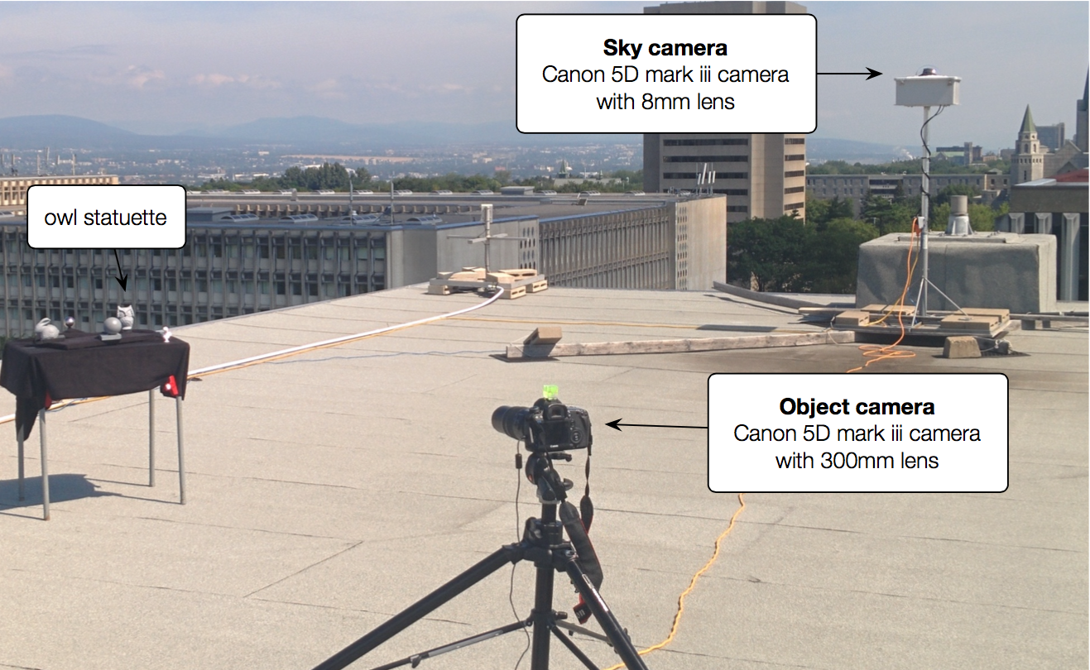
Real data—setup
Notes:
We gather some pictures and sky captures using two cameras.

Slide 40
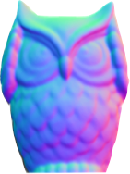
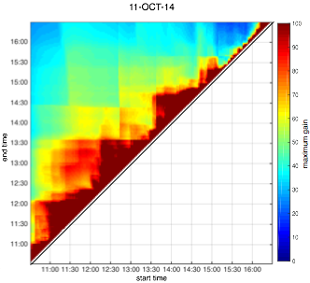
Analysis of the real owl images
Ground Truth
normals
60
50
40
30
20
10
0
Notes:
Fine-grained analysis
This is a real PS algorithm performed on real images for a full day reconstruction.

Slide 41
Recap
What needs to happen for PS to work?
Mean Light Vector shifts
Can it happen during less than a day?
Yes, MLV shifts happen in small time intervals (i.e., < 6 hours)
50% of the time, 3 hours intervals have similar performance
Notes:
What needs to happen?
MLV shifts, they must spread out!
Can it happen during less than a day?
Analysis in our database shows that most of the time, 3 hours intervals yield only a small degradation in performance over the whole day, 50% of the time.

Slide 42
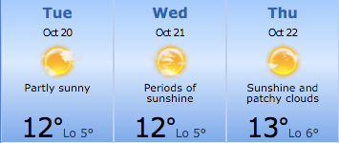
Want to perform PS in Lyon?
Wednesday
Notes:
If you want to capture these days for oPS, you’re lucky! Tomorrow would be a pretty good day, slightly windy, enough to move the 50% cloud cover around, so most time intervals should work well during that day.

Slide 43
Thank you!
hdrdb.com
http://vision.gel.ulaval.ca/~jflalonde/projects/xHourPS
Notes:
Add hdrdb.com

Slide 44
Extra slides

Slide 45
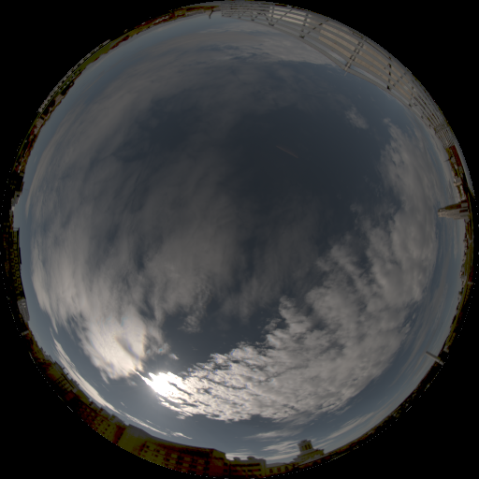
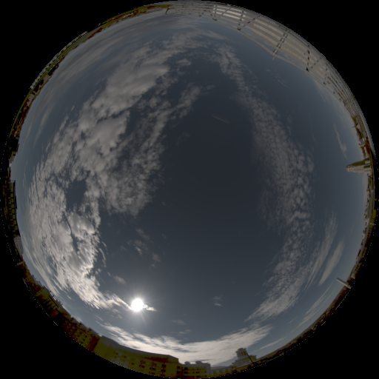
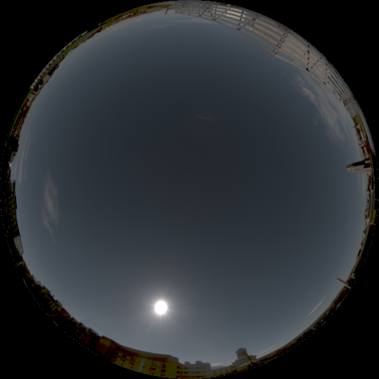
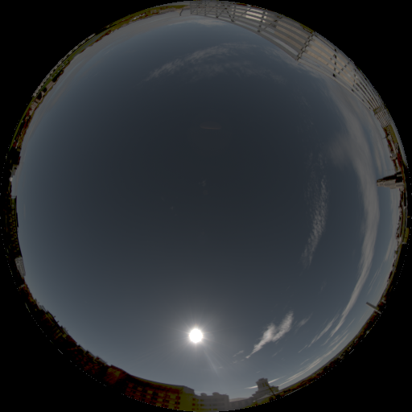
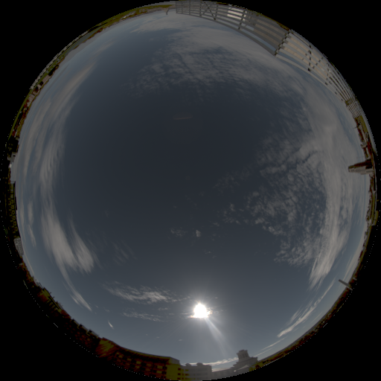
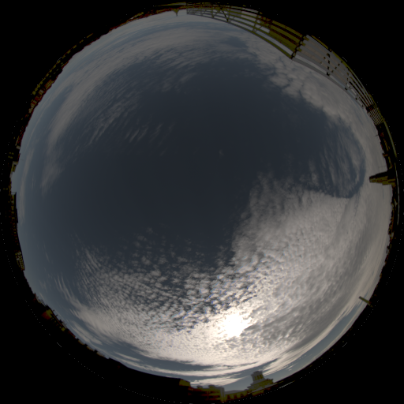
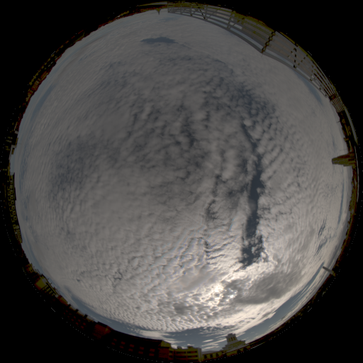
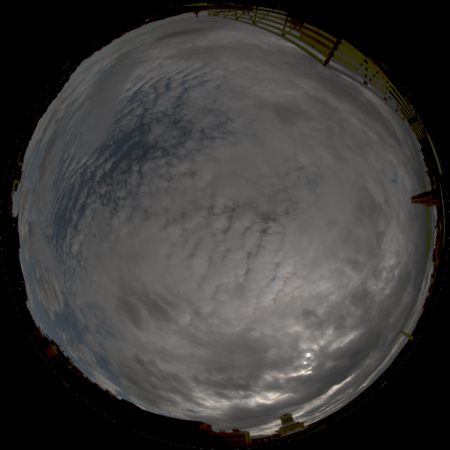
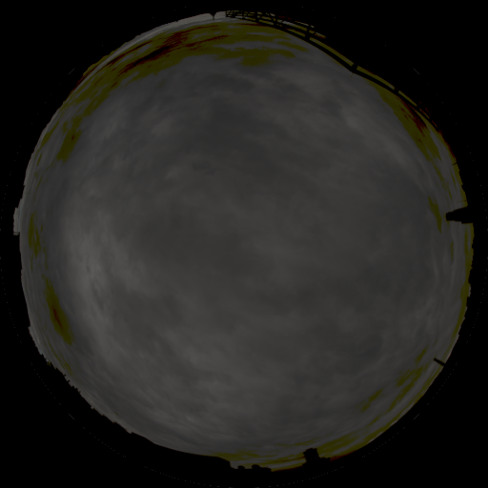
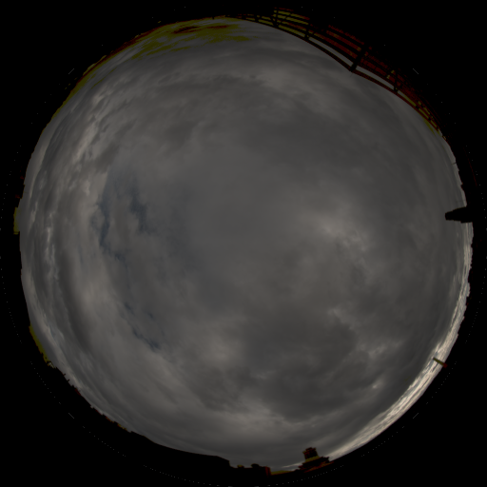
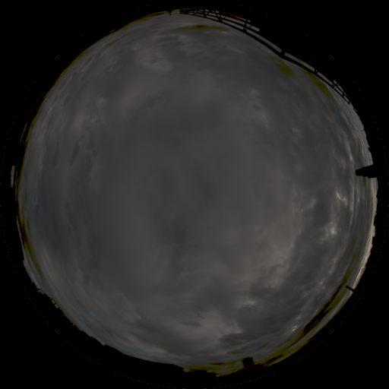
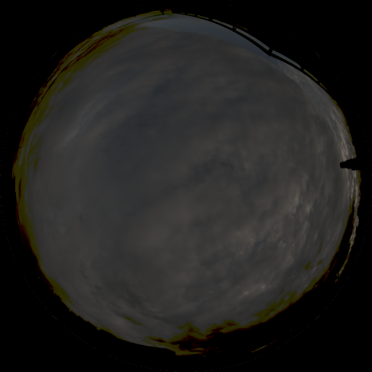
PS reconstruction on synthetic images
Real sky probes, no inter-reflections, highlights or cast shadows
11h
12h
13h
14h
15h
16h
environment
map
rendered
images
Notes:
We validated our analysis first on synthetic data which we rendered using the real sky probes, without inter-reflections or cast shadows and with 1% gaussian noise.

Slide 46
Real data
Owl statuette
3D scan
Normal map

Slide 47
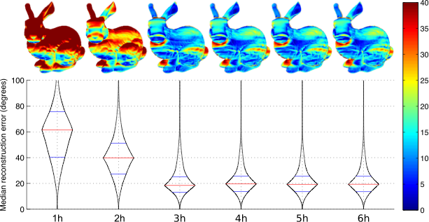
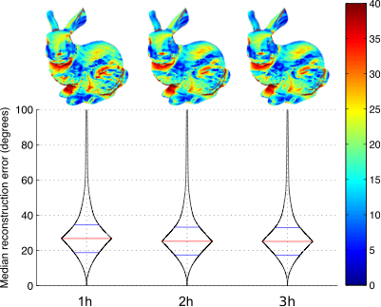
Results on synthetic bunny images
Real sky probes, with inter-reflections, highlights and cast shadows

Slide 48
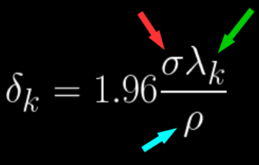
Metric: maximum uncertainty
We now focus on the conditioning of matrix L (noise gain factor)
Independent of albedo and sensor noise
Notes:
[Add the equation for the max gain]
This is what we’re going to use to quantify the reconstructability of a normal
Amplification of noise.

Slide 50
08/24/2013
light clouds
85% sun visibility
11/06/2013
mixed
41% sun visibility
11/08/2014
overcast
16% sun visibility
Notes:
Using these environment maps, we previously investigated the reconstruction performance of a given day. This analysis showed the relative precision we could expect for any given normal in the reconstruction.

Slide 51
How?
light
direction
scaled
surface
normal
Online database: hdrdb.com
pixel
intensity

Slide 52
Mean Light Vector shifts
Overcast
Partly cloudy

Slide 53
Photometric Stereo in the lab
Unknown, smooth lighting
(Spherical Harmonics)
Non-parametric,
spatially-varying reflectance
Robust estimation of
complex BRDF models
[Basri et al., IJCV ’07]
[Alldrin et al., CVPR ’08]
[Ikehata et al., CVPR ’12]
Notes:
Over the years, this technique was enhanced to provide algorithms supporting unknown and more complex lighting, complex materials (such as non-parametric, spatially varying reflectance) and increasing robustness to noise and specularities that are hard to model.

